Slide 1
Crises, Public Debt and Interest Rates.
Off-Code Changes
Anna Karina Pérez Peña
Sebastián Ocampo Palacios

Slide 2
Aesthetical Off-Code Changes
Import “data-vis.png” from crises-debt-rates folder on GitHub
Know that the size of the picture is 14.7 x 22.05 cm. (HxW), font is Roboto Condensed and that colours are
Changes in Interest Rates (HEX: #69b3a2 )
Changes in Public Debt (HEX: #3399E6)
Add main title, subtitle, caption and legend.
Group and copy+paste as picture.
Right click, select Format Picture, Fill and choose Solid Fill (“White).
Save as Picture.

Slide 3
Legend
Changes in Interest Rates
Changes in Public Debt

Slide 4
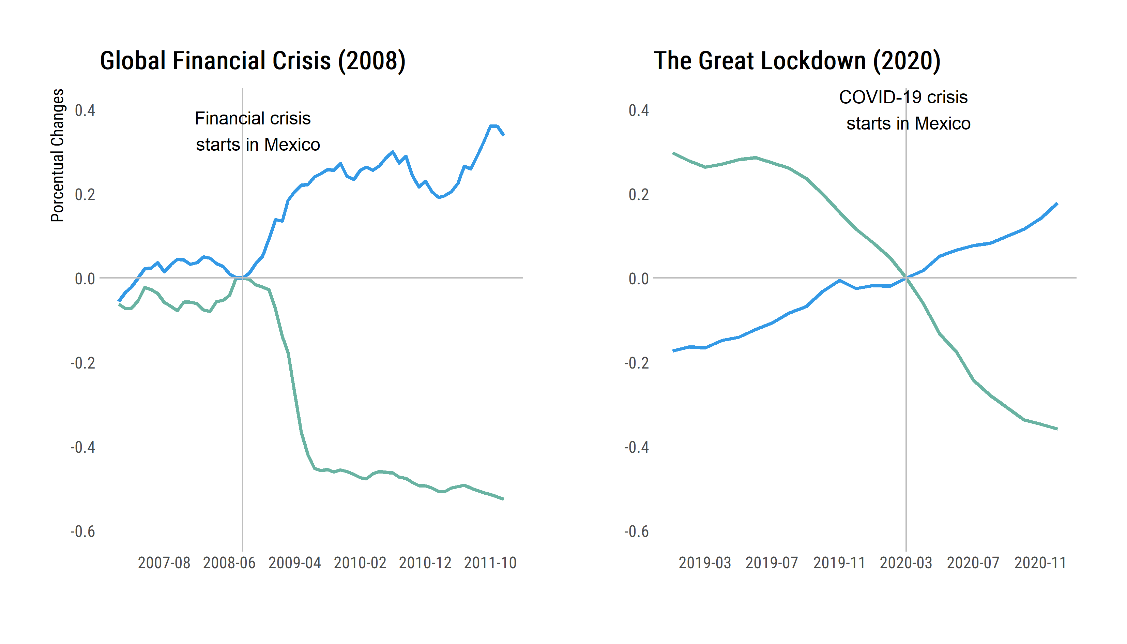
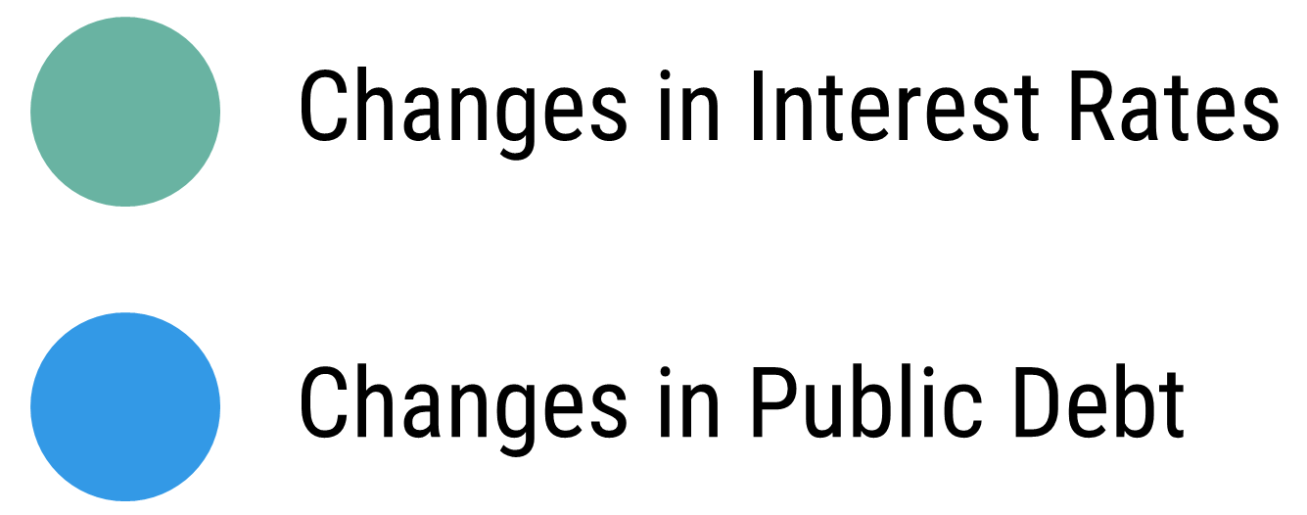
Interbank Interest Rates and Internal Public Debt During Crises
A visual analysis of the relationship between internal public debt and the loan market in Mexico during the 2008 and 2020 economic crises: no relevant changes in variation patterns are observed during the COVID-19 crisis unlike the 2008 financial crisis.
Financial Crisis
starts in Mexico
COVID-19 Crisis
starts in Mexico
Methodological Note: Seasonal and inflation adjusted data. We appplied a linear transformation in order to redefine the porcentual changes and normalized the initial values of each crisis equal to zero.
Source: BANXICO, Sistema de Información Económica
Authors: Karina Pérez, Sebastián Ocampo https://github.com/socapal/crises-debt-rates/

Slide 5
